Slide 1
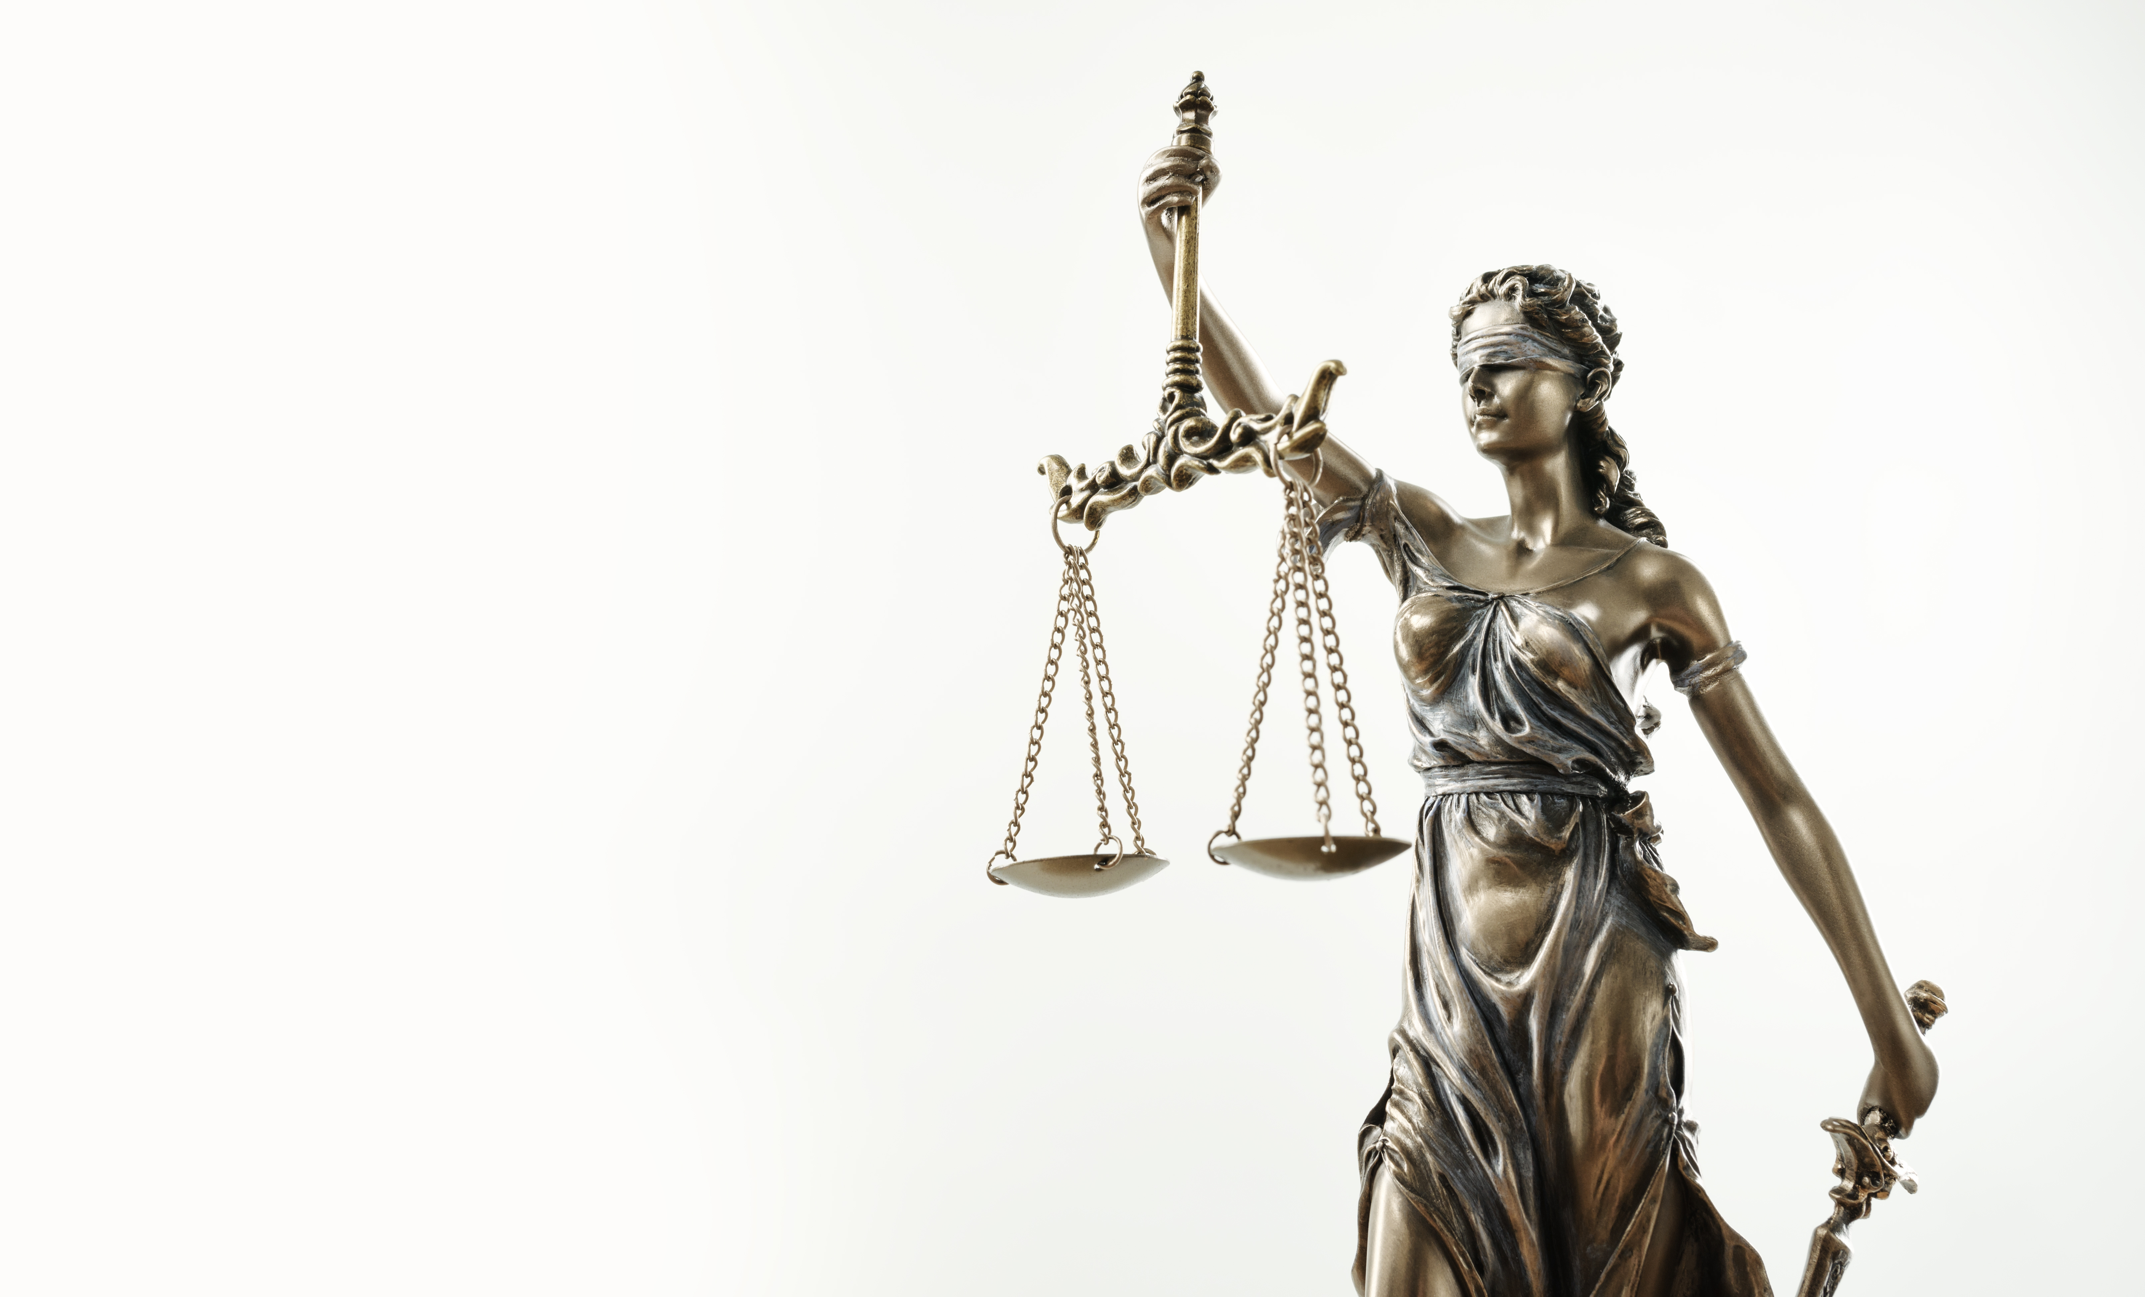

CC0003 Ethics and Civics in a Multicultural World
Week 08: Justice and Equality
Prof Walid Jumblatt Bin Abdullah

Slide 2
Learning Objectives
By the end of this lecture, you should be able to:
Explain the morally relevant features of justice in a multicultural world.
Identify the differences between justice and equality.
Explain the morally relevant features of inequality in a multicultural world.

Slide 3
Outline
The following topics will be covered in this lecture:
Justice
Justice versus equality
Inequality
Conclusion

Slide 4
CC0003 Ethics and Civics in a Multicultural World
Week 08: Justice and Equality
Topic 01: Justice
Prof Walid Jumblatt Bin Abdullah

Slide 5
Justice: Background
A concept which permeates the consciousness of human beings.
Little children like to say, ‘that’s not fair’.
Religions propound the concept of a ‘Just’ God,
which has to be balanced with a ‘Merciful’ God,
hence, the existence of hell and heaven.
We seek recourse in our ‘justice system’.
We talk about needing to ‘do justice’ to something.
When people wrong us, we talk about them getting their ‘just deserts’.

Slide 6
Justice: Approaches
Expansive approach
What makes a human being worthy of good (or bad) things?
Sees justice as a broad moral category
Constrained approach
What is a human being owed?
Sees justice as how benefits and burdens are to be allocated

Slide 7
Justice: Concept
Justice is the normative lens through which we assess social institutions.
Justice concerns the proper exercise of the coercive power social institutions wield.
For instance, whether a state can enforce capital punishment, what sentences are appropriate for each crime, inter alia.
Justice is also about the distribution of resources, and related questions of deservedness and worthiness.

Slide 8
Acknowledgements:
Slide 1, 4 - 7: Sikov (n.d.). Themis Statue Justice Scales Law Lawyer Concept [Photograph]. Adobe Stock Images. https://stock.adobe.com/sg/images/themis-statue-justice-scales-law-lawyer-concept/275154151

Slide 9
CC0003 Ethics and Civics in a Multicultural World
Week 08: Justice and Equality
Topic 02: Justice vs Equality
Prof Walid Jumblatt Bin Abdullah

Slide 10
Justice versus Equality
Question: Does being just mean being ‘equal’?
And if so, what does ‘equal’ mean?
Does it mean ‘sameness’ of treatment?
But sameness of treatment can be unjust
For instance, if student A worked hard and student B did not, yet they are given the same grade, that would be unjust.
Broader question: What ensures justice?
Equality of opportunity versus equality of outcome
Is equality even attainable?
Perhaps not but does not mean we should not try!

Slide 11
Acknowledgements:
Slide 9: Sikov (n.d.). Themis Statue Justice Scales Law Lawyer Concept [Photograph]. Adobe Stock Images. https://stock.adobe.com/sg/images/themis-statue-justice-scales-law-lawyer-concept/275154151

Slide 12
CC0003 Ethics and Civics in a Multicultural World
Week 08: Justice and Equality
Topic 03: Inequality
Prof Walid Jumblatt Bin Abdullah

Slide 13
Inequality: Concept
Definition (United Nations): The state of not being equal, especially in status, rights, and opportunities.
Could be based on race, religion, gender, sexuality, or wealth and income.
Economic inequality cuts across cleavages.
Inequality is identified through outcomes, but usually (though not always) is a result of opportunities.

Slide 14
Inequality: Why Does It Matter?
Moral dimension:
Surely, inequality is unjust?
Or at least, it can be!
For example, in 2018, an average middle-class American earning US$50,000 – 75,000 annually paid over US$4,600 in taxes, whereas Amazon paid 0!
Assuming economic inequality is a result of lack of opportunity.
Question: What if economic inequality is not a result of lack of opportunities?

Slide 15
Inequality: Why Does It Matter?
Socio-political dimension:
An unequal society is a recipe for social disaster.
Analogy
Two teams are playing a football game.
One team wins.
The team which loses genuinely believes that the game was rigged.
Not only would they not accept the result of the game, but they would also try to change the entire game and system, and may even be willing to sacrifice the essence of the game.
Inequality may make people lose trust in the system.

Slide 16
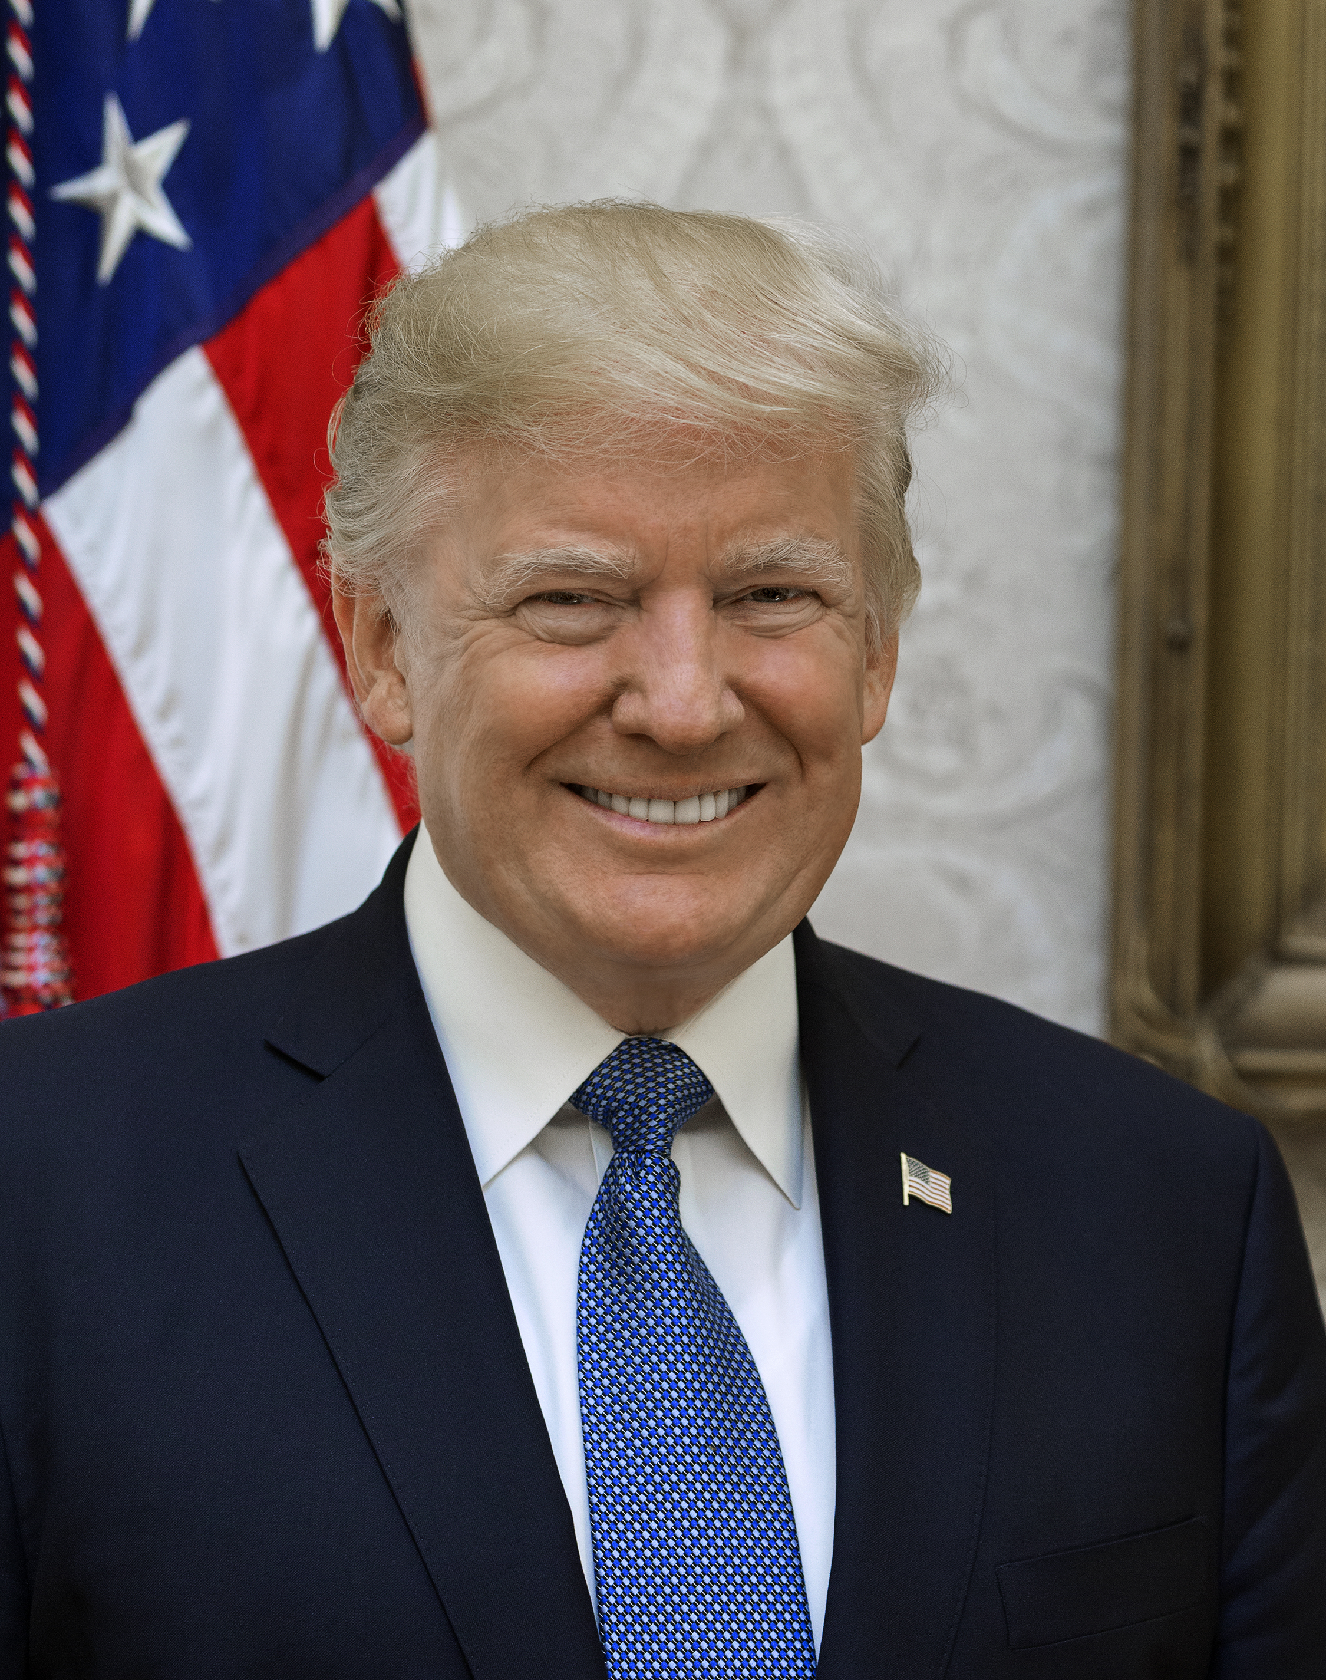
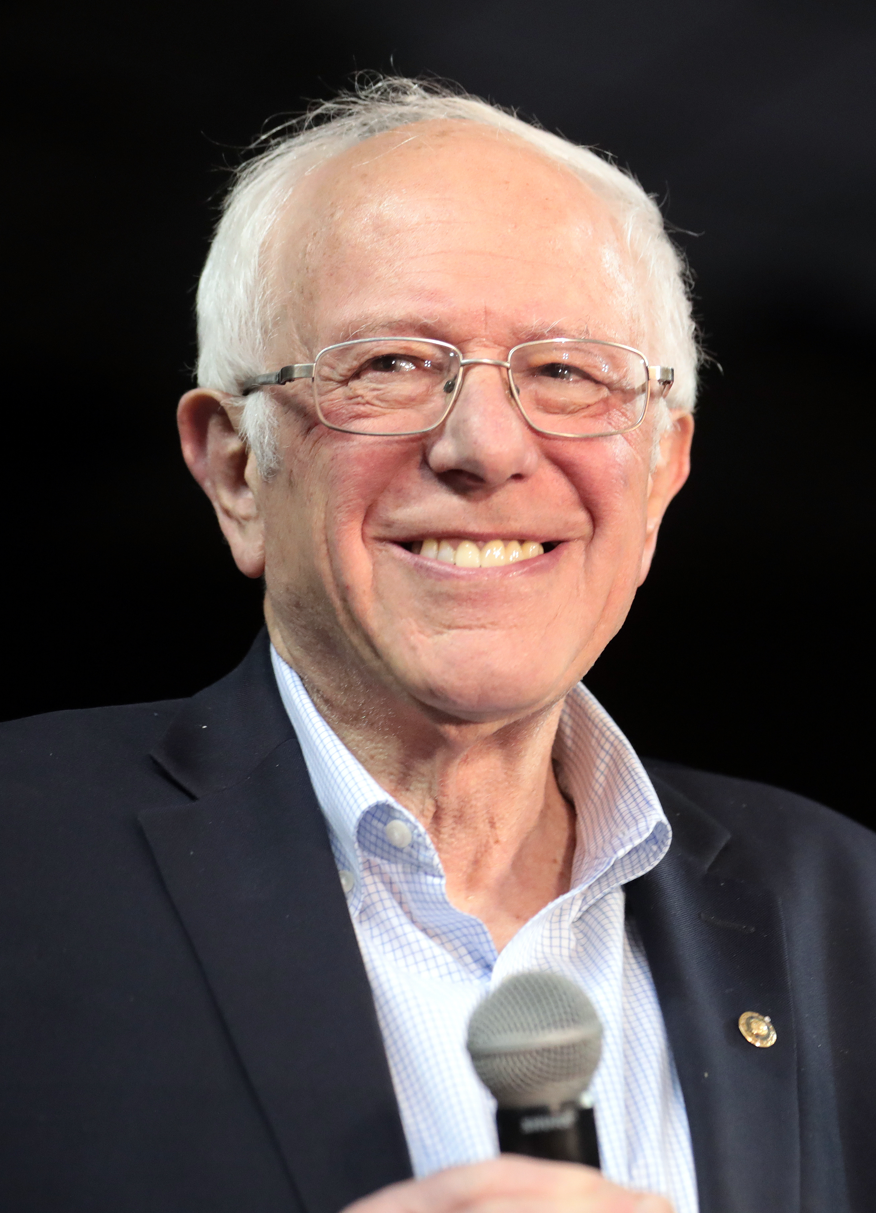
Inequality: Why Does It Matter?
Donald Trump
Bernie Sanders

Slide 17
Inequality: Why Does It Matter?
When citizens lose trust in the system, populists are better able to rise to power.
Populist: A person who rallies the masses against a supposedly corrupt establishment or elite
Examples: Duterte, Trump, Modi, Bernie Sanders and AOC
Trump’s rise was more than just about racism or sexism.
Economic inequalities and woes are more powerful explanatory variables.

Slide 18
Inequality: Data
In the US:
Top 20% of earners made over 50% of total income.
Top 50 wealthiest persons own almost as much as half the country.
Black-White income gap has persisted over time.
In India:
Top 10% own 77% of the national wealth.
Inequality exacerbates the effects of COVID-19.

Slide 19
Inequality: Data
Wealth distribution
Top 20% own 73% of wealth (estimated by Credit Suisse).
Even within this, there is uneven distribution.
Increase in income gap between top 10% and bottom 10% earners
2000: $5,486
2007: $8,236
2017: $12,661
Gini coefficient (2019)
0.452 (one of the highest in the developed world)
Commitment to Reducing Inequality Index (Oxfam)
149th position (out of 157 countries)

Slide 20

Inequality: This Is What It Looks Like
This Is What
Inequality
Looks Like
Essays by
Teo You Yenn

Slide 21
Inequality: This Is What It Looks Like
Inequality is more than just about statistics and data.
It is about the actual day-to-day realities or “lived experiences”.
Teo You Yenn (TYY) documents these lived experiences.
Different environments in the rental flats.
Low-income parents cannot take leave so easily even when their children are sick.
Extend this to the pandemic: Effects of a lockdown are not the same for everyone!

Slide 22
Inequality: This Is What It Looks Like
Example: Consider two boys, Ahmad and James:
Ahmad is an only child. He lives in a five-room flat, has a dual-income family with a domestic helper.
James lives in a (one-room) rental flat, with his mother and four other siblings. His dad has been absent for the past few years. His mother is working two shifts to make ends meet.
Who do you think will suffer more from a lockdown?

Slide 23
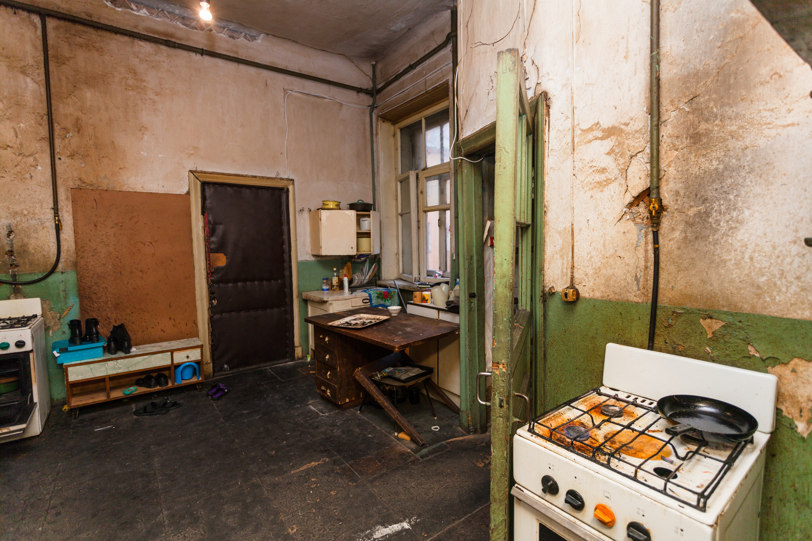
Inequality: This Is What It Looks Like

Slide 24
Inequality: What Do We Do?
Nothing
If your assessment is that the inequality is due to the merit, then does it make sense that you do anything to correct the outcome?
Would it be just to do anything?
Redistribution
Minimum wage, higher taxes for the rich, etc.
However, would that affect individual motivation?
Recent research seems to suggest that it would not.
What about foreign investment (in the context of Singapore)?
Equalising opportunities
But how exactly?

Slide 25
Acknowledgements:
Slide 12: Sikov (n.d.). Themis Statue Justice Scales Law Lawyer Concept [Photograph]. Adobe Stock Images. https://stock.adobe.com/sg/images/themis-statue-justice-scales-law-lawyer-concept/275154151
Slide 14: Donald Trump. (2021, July 19). In Wikipedia. https://en.wikipedia.org/wiki/Donald_Trump
Slide 14: Bernie Sanders. (2021, July 12). In Wikipedia. https://en.wikipedia.org/wiki/Bernie_Sanders
Slide 20: mileswork (n.d.). blank vector book on white [Photograph]. Adobe Stock Images. https://stock.adobe.com/sg/images/blank-vector-book-on-white/79329642
Slide 23: Zakhar Marunov (n.d.). Dirty kitchen is in the temporary apartment for living (existence) refugees [Photograph]. Adobe Stock Images. https://stock.adobe.com/sg/images/dirty-kitchen-is-in-the-temporary-apartment-for-living-existence-refugees/135224302

Slide 26
CC0003 Ethics and Civics in a Multicultural World
Week 08: Justice and Equality
Topic 04: Conclusion
Prof Walid Jumblatt Bin Abdullah

Slide 27
Conclusion
Justice is something embedded in the consciousness of human beings.
We must understand that the understanding of justice may differ across cultures and traditions, and even within the same tradition.
For example, Al-Attas defined justice as putting things in their proper place.
The question of economic inequality must be considered in tandem with our understandings of justice.
What is just and unjust; what is the equality that we seek; which equality is more ‘just’
Inequality has many practical consequences, in addition to the ‘moral’ question.

Slide 28
Questions
Why did TYY’s book sell so well?
Did it speak to Singaporeans’ ‘innate’ sense of justice and morality?
If inequality is a global problem, is there anything realistic we can do about it?
Are human beings selective about their applications of justice and morality?
Is inequality immoral and unjust?

Slide 29
Acknowledgements:
Slide 26: Sikov (n.d.). Themis Statue Justice Scales Law Lawyer Concept [Photograph]. Adobe Stock Images. https://stock.adobe.com/sg/images/themis-statue-justice-scales-law-lawyer-concept/275154151

Slide 30
